Slide 1
Characterizing Processors for Energy and Performance Management
Harshit Goyal Vishwani D. Agrawal
Master’s Student James J. Danaher Professor
Department of Electrical and Computer Engineering
Auburn University
December 4, 2015

Slide 2
Outline
Problem Statement
Background
Methodology
Simulation setup
Results
Applications
Conclusion

Slide 3
Problem Statement
Obtain data on voltage, frequency and cycle efficiency of the processor for power and performance management.
Determine operating conditions (voltage and frequency) for optimal time energy operations.

Slide 4
Background

Slide 5
Where Does Power Go in CMOS?
Dynamic Power
Due to charging and discharging of capacitances.
Short Circuit Power
Occurs during signal transitions when both pullup and pulldown paths are partially conducting causing a direct path between Vdd and GND.
Static Power
This power dissipation occurs all the time through leakage even when the device is in standby mode.

Slide 6
Characterization
What is Characterization?
Characterization over Process, Voltage, Frequency, Power, Temperature
Performance Metric
Energy Efficiency Metric

Slide 7
Performances Measures
Time Performance of Processor
Speed of a processor is measured in cycles per second or clock frequency (f).
Execution time of a program using C clock cycles = C/f
Time performance = f/C
Energy Performance of a Processor
Efficiency of a processor may be measured in cycles per joule or cycle efficiency (η).
Energy dissipated by a program using C clock cycles = C/η
Energy performance = η/C

Slide 8
Methodology
Technology Characterization
Simulate a reasonable size adder circuit using selected vectors.
Scale adder data to obtain processor power (cycle efficiency) and frequency at different operating points using scale factors.
Develop power management scenarios using cycle efficiency and frequency.

Slide 9
Simulation Tools Used
Questa Sim
Design, compile and simulate designs
Leonardo Spectrum
ASIC and standard cell synthesis
Design Architect-IC
Schematic Capture
HSPICE
Circuit simulation and verification

Slide 10
Micro-Benchmark Circuit Used
Adder circuit
Fundamental block of functional units
Often in processor’s critical path
Used 16-bit Ripple Carry Adder.
PTM Models
Characterized in two PTM models: bulk CMOS and High-K
Technology node: 45nm, 32nm and 22nm

Slide 11
Results

Slide 12
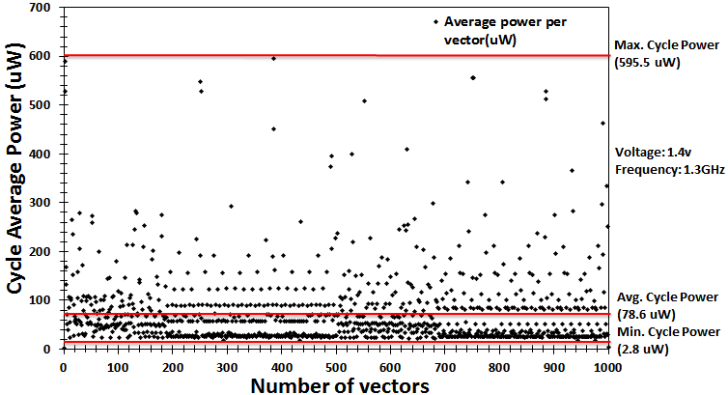
Vector Selection
1000 random vectors were generated using a MATLAB code
Simulation in H-spice at voltage 1.4v and frequency 1.3GHz gives cycle avg. power
100 vectors were selected such that:
34 consume avg. power
33 are above avg. power including the peak power vector
33 consume below avg. power including the min. power vector.

Slide 13
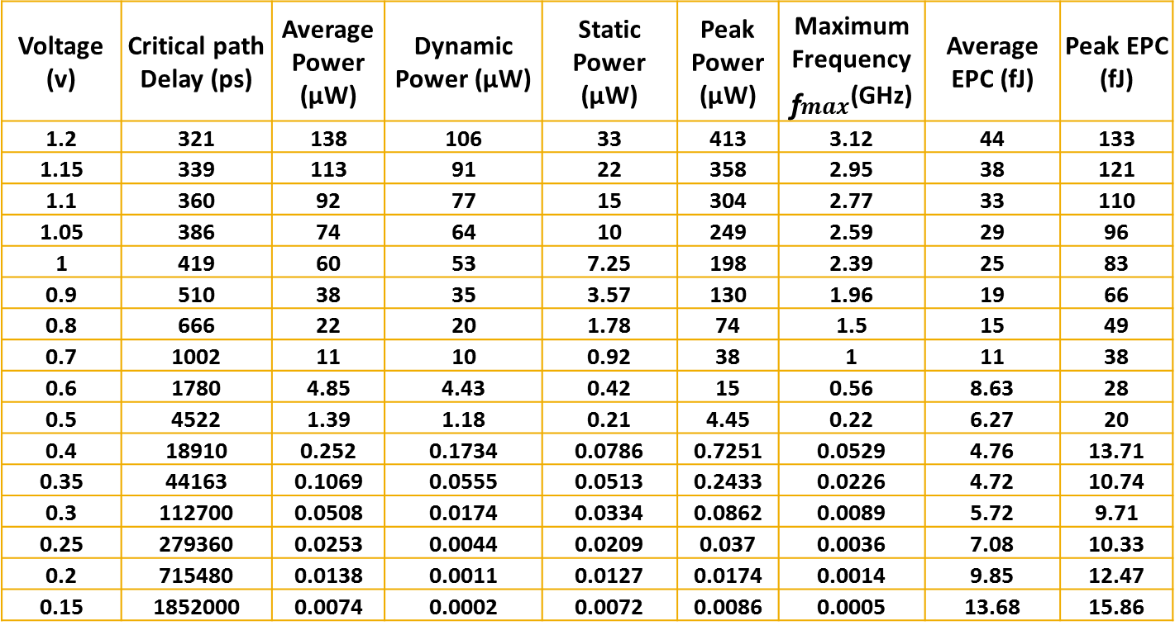
Adder Simulation Data
Voltage (v) | Critical path Delay (ps) | Average Power (µW) | Dynamic Power (µW) | Static Power (µW) | Peak Power (µW) | Maximum Frequency ${\text{ƒ}}_{max}$(GHz) | Average EPC (fJ) | Peak EPC (fJ)
1.2 | 321 | 138 | 106 | 33 | 413 | 3.12 | 44 | 133
1.15 | 339 | 113 | 91 | 22 | 358 | 2.95 | 38 | 121
1.1 | 360 | 92 | 77 | 15 | 304 | 2.77 | 33 | 110
1.05 | 386 | 74 | 64 | 10 | 249 | 2.59 | 29 | 96
1 | 419 | 60 | 53 | 7.25 | 198 | 2.39 | 25 | 83
0.9 | 510 | 38 | 35 | 3.57 | 130 | 1.96 | 19 | 66
0.8 | 666 | 22 | 20 | 1.78 | 74 | 1.5 | 15 | 49
0.7 | 1002 | 11 | 10 | 0.92 | 38 | 1 | 11 | 38
0.6 | 1780 | 4.85 | 4.43 | 0.42 | 15 | 0.56 | 8.63 | 28
0.5 | 4522 | 1.39 | 1.18 | 0.21 | 4.45 | 0.22 | 6.27 | 20
0.4 | 18910 | 0.252 | 0.1734 | 0.0786 | 0.7251 | 0.0529 | 4.76 | 13.71
0.35 | 44163 | 0.1069 | 0.0555 | 0.0513 | 0.2433 | 0.0226 | 4.72 | 10.74
0.3 | 112700 | 0.0508 | 0.0174 | 0.0334 | 0.0862 | 0.0089 | 5.72 | 9.71
0.25 | 279360 | 0.0253 | 0.0044 | 0.0209 | 0.037 | 0.0036 | 7.08 | 10.33
0.2 | 715480 | 0.0138 | 0.0011 | 0.0127 | 0.0174 | 0.0014 | 9.85 | 12.47
0.15 | 1852000 | 0.0074 | 0.0002 | 0.0072 | 0.0086 | 0.0005 | 13.68 | 15.86
Simulation Data from H-spice for 32nm Bulk CMOS PTM Model
Notes:
Dynamic static power

Slide 14
Processor Specifications
Processor Specifications:
Intel Sandy bridge 2500K
Technology node - 32nm
Voltage range – 1.2v to 1.5v
Overclock Speed (${\text{ƒ}}_{1}$)- 5.01GHz
Clock Speed (${\text{ƒ}}_{2}$)- 3.3GHz
Peak Power ($P_{1}$)-125.6W
TDP ($P_{2}$)- 95W
Assuming that voltage was not raised for overclock frequency, using the equations below we found the static (36W) and dynamic power (59W) for the processor at the rated voltage 1.2 volts.
$P_{s}=P_{1}−\frac{P_{1}−P_{2}}{f_{1}−f_{2}}×{\text{ƒ}}_{1}$ $P_{d}=E_{d}×f_{1}$

Slide 15
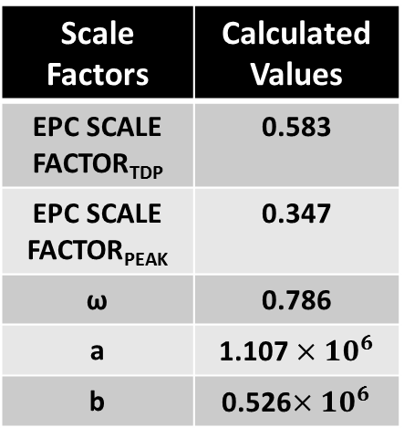
Scaling Factors
All the scaling factors were found using processor’s specifications given at rated voltage 1.2v.
Scale factors for processor’s EPC:
EPC SCALE FACTOR_{TDP} = $\frac{{EPC}_{TDP} Processor}{{EPC}_{TDP Adder}}$
EPC SCALE FACTOR_{PEAK} = $\frac{{EPC}_{Peak} Processor}{{EPC}_{Peak Adder}}$
Scale factors for processor’s frequency:
Structural Constrained Frequency: $\text{ω}=\frac{Processor^{′}s Frequency}{Adder^{′}s Frequency }$
Power Constrained Frequency (a and b):
$a=\frac{P_{Static }Processor^{′}s}{P_{static }Adder}$ $b=\frac{P_{dynamic }Processor^{′}s ×{ f}_{Adder}}{P_{dynamic}Adder ×{ f}_{Processor}}$
Scale Factors | Calculated Values
EPC SCALE FACTOR_{TDP} | 0.583
EPC SCALE FACTOR_{PEAK} | 0.347
ω | 0.786
a | 1.107$×{10}^{6}$
b | 0.526$×{10}^{6}$
Notes:
${Processor EPC}_{TDP }= \frac{Thermal Design Power}{Nominal Frequency}=$ $\frac{95 Watt}{3.3×{10}^{9}Hertz}=$28.78nJ
$Processor {EPC}_{Peak }= \frac{Peak Power}{Structural Frequency}$= $\frac{125.6 Watt}{5.01×{10}^{9}Hertz}$= 25.06nJ
SCALING FACTOR_{TDP} = $\frac{{EPC}_{TDP} Processor}{{EPC}_{TDP Adder}}=\frac{28.78×{10}^{−9}}{44.39×{10}^{15}}=0.583$
SCALING FACTOR_{PEAK} = $\frac{{EPC}_{Peak} Processor}{{EPC}_{Peak Adder}}=\frac{25.06×{10}^{−9}}{132.54×{10}^{15}}=0.347$

Slide 16
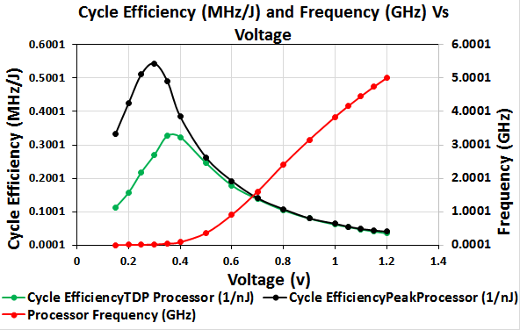
Processor Cycle Efficiency and Frequency vs. Voltage
Because our own greatest access and insight involves Intel designs and data, our graphs and estimates draw heavily on them.
Notes:
Epc vs voltage

Slide 17
Application

Slide 18
Power and Structure Constrained Frequency
Power constrained frequency : It is the frequency that is limited by the maximum rated power (TDP) for the circuit under test.
Power Constrained Frequency $=\frac{TDP − a P_{Static }Adder}{b{ EPC}_{Dynamic }Adder}$
Structure constrained: It is the frequency that is limited by the structural (critical path) delay of the circuit under test.
Structural Constrained Frequency $=\text{ω}×Adder^{′}s Frequency$

Slide 19
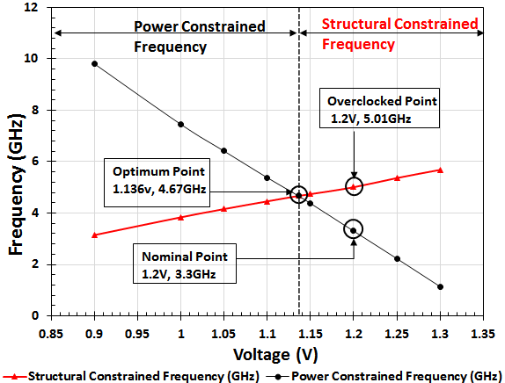
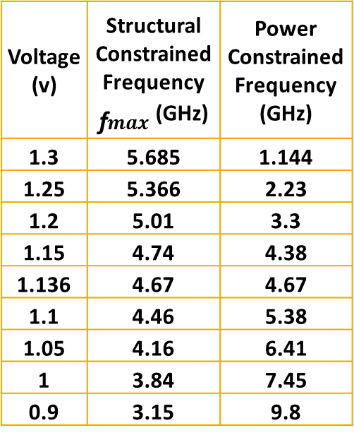
Power and Performance Management
Voltage (v) | Structural Constrained Frequency ${\text{ƒ}}_{max}$(GHz) | Power Constrained Frequency (GHz)
1.3 | 5.685 | 1.144
1.25 | 5.366 | 2.23
1.2 | 5.01 | 3.3
1.15 | 4.74 | 4.38
1.136 | 4.67 | 4.67
1.1 | 4.46 | 5.38
1.05 | 4.16 | 6.41
1 | 3.84 | 7.45
0.9 | 3.15 | 9.8

Slide 20
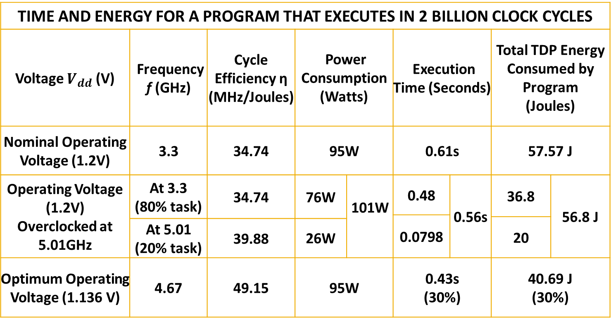
Power and Performance Management cont.…
TIME AND ENERGY FOR A PROGRAM THAT EXECUTES IN 2 BILLION CLOCK CYCLES
Voltage $V_{dd}$ (V) | Frequency f (GHz) | Cycle Efficiency η (MHz/Joules) | Power Consumption (Watts) |  | Execution Time (Seconds) |  | Total TDP Energy Consumed by Program (Joules)
Nominal Operating Voltage (1.2V) | 3.3 | 34.74 | 95W |  | 0.61s |  | 57.57 J
Operating Voltage (1.2V) Overclocked at 5.01GHz | At 3.3 (80% task) | 34.74 | 76W | 101W | 0.48 | 0.56s | 36.8 | 56.8 J
 |  |  |  |  | 0.0798
 |  |  |  |  |  |  | 20
 | At 5.01 (20% task) | 39.88 | 26W
Optimum Operating Voltage (1.136 V) | 4.67 | 49.15 | 95W |  | 0.43s (30%) |  | 40.69 J (30%)
$$\frac{f}{η}$$
$$\frac{C}{η}$$

Slide 21
Conclusion
The results shows efficiency improvement method for processor.
Applicable to any technology node for which the modelling data is available.
Power management can achieve higher performance (30% reduction in execution time and 30% lower energy consumption)
Overclocking with increase in voltage can still improve the performance further.

Slide 22
References
[1] D. A. Patterson and J. L. Hennessy, Computer Organization& Design, the Hardware/Software Interface. San Francisco, California: Morgan Kaufman, fourth edition, 2008.
[2] Aditi shinde and V. D. Agrawal, “Managing Performance and Efficiency of a Processor”, in proc. 45th Southeastern Symp. System Theory, 2013.
[3] "CPUBoss." CPUBoss. Web. 25 Sept. 2014.
[4] K. Kim and V. D. Agrawal, “Dual Voltage Design for Minimum Energy using Gate Slack,” in Proc. International Conf. on Industrial Technology, 2011, pp. 419–424.
[5] K. Kim and V. D. Agrawal, “Minimum Energy CMOS Design with Dual Subthreshold Supply and Multiple Logic-Level Gates,” in Proc. International Symp. Quality Electronic Design, 2011, pp. 689–694.
[6]. Bienia, C. et. al. The PARSEC benchmark suite: Characterization and architectural implications. The 17th International Symposium on Parallel Architectures and Compilation Techniques (2008).
[7]. Borkar, Shekhar, and Andrew A. Chien. "The future of microprocessors."Communications of the ACM 54.5 (2011): 67-77.
[8] Wang, A; Chandrakasan, AP.; Kosonocky, S.V., "Optimal supply and threshold scaling for subthreshold CMOS circuits," VLSI, 2002. Proceedings. IEEE Computer Society Annual Symposium on , vol., no., pp.5,9, 2002

Slide 23
Questions?
Thank You

